Slide 1

Statistics 2022
Top Sport
199
Days
186 in 2021
Time
190
hours
156 in 2021
Distance
1,540
km
1,333 in 2021
Elevation
8,062
m
5,977 in 2021

Slide 2
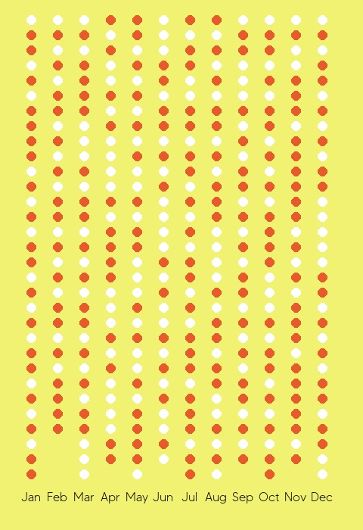
Days active
198
Activities per month
Days active in 2021
186

Slide 3
Sports
Total 221 activities
Run: 174 – 79%
Walk: 31 – 14%
Hike: 9 – 4%
Workout: 5 – 2%
Ride: 2 – 1%
Sports
Sports in 2021
222 activities
Run: 127 – 57%
Ride: 32 – 14%
Walk: 30 – 13%
Rowing: 17 – 7%
Hike: 14 – 6%
Workout: 2 – 1%

Slide 4
Achievements
97 Personal Records including:
400m: 01m52s on Sat 15 October
1k: 4m49s on Sun 13 November
½ mile: 3m51s on Sun 13 November
1 mile: 07m53s on Sat 15 October
2 mile: 17m03s on Thu 25 August
5k: 27m16s on Mon 19 Dec
10k: 59m04s on Sun 23 October 2022
15k: 1h32m22s on Sun 06 November
10 mile: 1h38m58s on Sun 06 November
20k: 2h04m09s on Sun 06 November
Half Marathon: 2h11m30s on Sun 06 November

Slide 5
Total Time
190 hours
Time in 2021: 155h
Time

Slide 6
Total Distance
1,540 km
Distance in 2021: 1,333km
Distance

Slide 7
Total Elevation
8,062 m
Elevation in 2021: 5,977m
Elevation

Slide 8

Total Kudos
Kudos Received:
1,161
Thank you friends!
Most Kudo’d Activity:
16 kudos
Golden Gate Half Marathon 2022 on Sunday 06 November

Slide 9
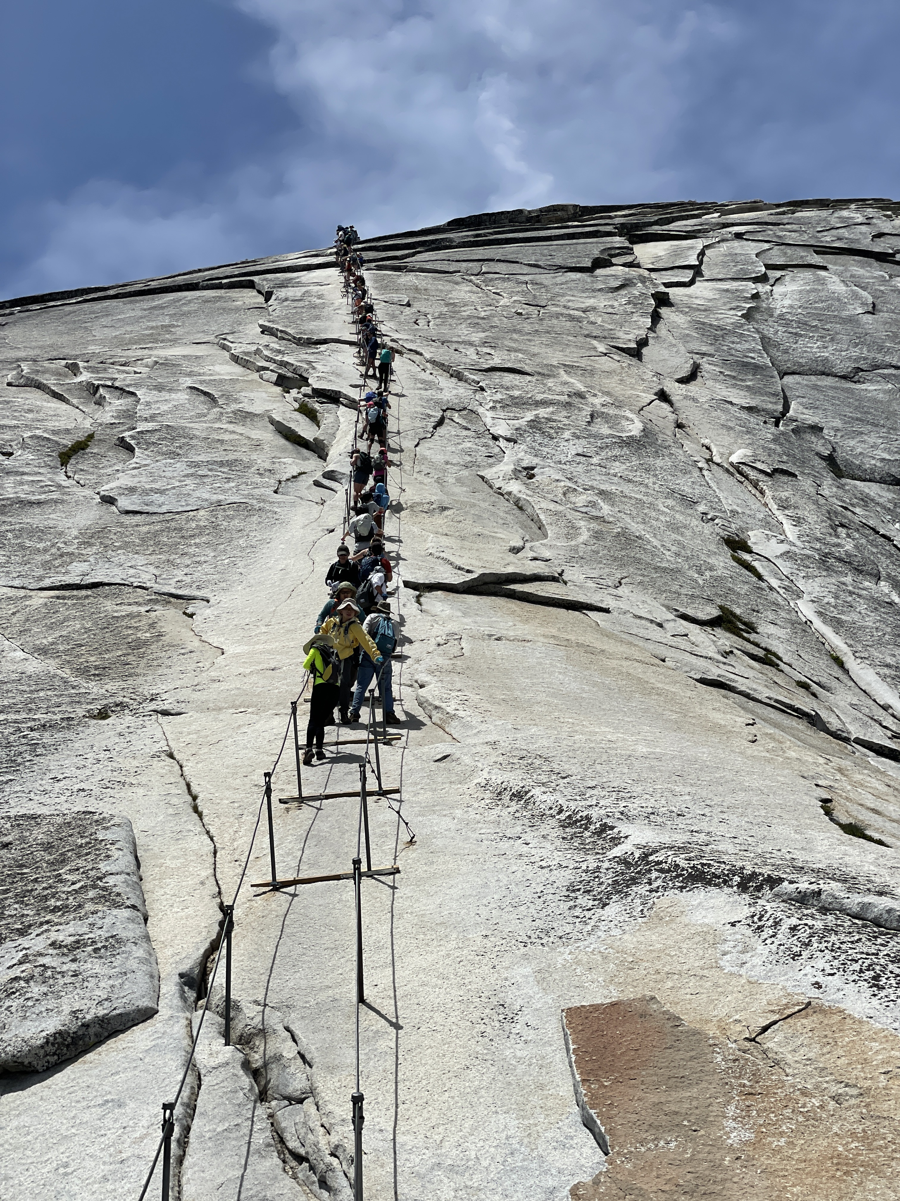
Hikes 2022
9 Hikes in 2022
14 Hikes in 2021
Longest Hike:
29 Km - 7h37m
Morning Hike – Half Dome on Tue 07 June

Slide 10
Runs 2022
174 runs in 2022
127 runs in 2021
Run distance in 2022: 1,255 km
Run distance in 2021: 893km
Run time in 2022:
131 h
Run time in 2021: 94h
Average run:
7.21 km
45m20s
6m17s/km

Slide 11
Runs 2022
Longest run:
21.38km
2h16m
Morning Run on Sun 16 October

Slide 12
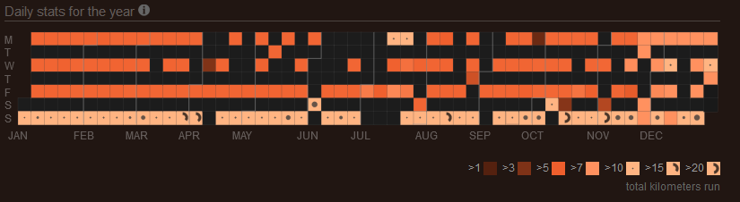
Runs 2022
Consecutive days run:
Longest break:
6 days
2 Jul – 7 Jul
Longest streak:
4 days
14 Oct – 17 Oct
Average runs per week:
3.3

